Slide 1
Annual Interagency Accessibility Forum
Unlocking the Power of Accessibility
October 11-13, 2022
Videos for All: Strategies for developing audio described videos
Lesley Earl, Ph.D., Andrew Wiley & Alison Lemon

Slide 2
Outline
What’s Missing? Exercise
Section 508 Requirements for Multimedia
About Audio Description
Creating Audio Described Videos
Posting and Promoting Audio Described Videos

Slide 3

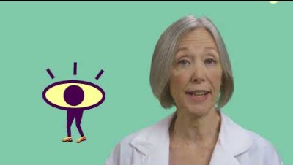
What’s missing?
Is this part of a video series?
Who is speaking?
Are they an expert? What is their profession?
WHERE is the lacrimal gland?
Notes:
Video transcription:
Child: What happens to my eyes when I cry?
Scientist: Anytime you cry, you think of tears, whether you're shedding a tear, or crying a bucket of them. All of these tears are produced by something called the lacrimal gland, that's located between the surface of the eye, and the eyelid, just above here.
There are three different kinds of tears. The first are basal tears, those are constantly produced, they keep your eye lubricated and nourished. The second kind, reflex tears, are actually produced in response to an irritant, like smoke in the air or a runaway eyelash on the surface of your eye. But what about when your best friend moves away, or you see a sad movie? Those tears, emotional tears, are produced, but scientists still don't know what their purpose is.

Slide 4
Section 508 Requirements for Multimedia

Slide 5
Section 508 multimedia requirements – 2018
Pre-recorded Synchronized media (Video and Audio)
Level A: Captions are provided for all pre-recorded audio content in synchronized media; Audio Description or transcript of the pre-recorded video content in synchronized media is provided
Level AA: Audio Description of pre-recorded video content in synchronized media is provided
Level AAA: Alternative is provided for pre-recorded synchronized media and video-only media; Sign language interpretation is provided for pre-recorded audio content in synchronized media; Extended audio description is provided for complex visuals in pre-recorded synchronized media
For more information about multimedia requirements: https://www.w3.org/WAI/media/av/planning/#wcag-standard

Slide 6
Other requirements for video
Captioning
Come see our next workshop about captioning!
Color contrast
All text and visual elements need sufficient contrast against background
Accessible video player
The video isn’t the only part of the experience – the player software also needs to be accessible
(keyboard access, toggles for CC and AD, etc.)
Details about accessible videos can be found at w3.org: https://www.w3.org/WAI/media/av/
Color Contrast Checker: https://www.tpgi.com/color-contrast-checker/

Slide 7
Audio Description

Slide 8
What does Audio Description mean?
Provides audio to convey visual-only information so that people without vision or with low vision can understand your media
Key ideas:
What does a viewer need to understand?
What is not being covered by the speaker?
Balance time versus completeness *
* The key is an equivalent experience. Some visual information may not be necessary to describe to understand what’s happening in the video.

Slide 9
Standard versus Extended Audio Description
Standard AD | Extended AD
Fits within breaks in existing audio elements | Video is paused to allow additional time between audio elements
Describes essential elements of visual info | Fully describes all relevant visual information
Does not alter the length of the video | Extends the length of the video
Balances towards brevity rather than completeness | Balances towards completeness rather than brevity

Slide 10
Language and content guidelines for AD
On-screen text (yes)
Key events (yes, when not evident in audio)
Facial expressions and body language (only when in contrast to audio content)
Age, appearance, race, ethnicity of people onscreen (only when relevant)
Clothing and other appearance (when relevant)
Other visual events on screen (no)
Tone & style: Neutral tone, person-focused descriptions, evocative nouns and verbs, style in keeping with video content

Slide 11
Creating AD videos

Slide 12
How would you describe the video?
Is this part of a video series?
Who is speaking?
Are they an expert? What is their profession?
WHERE is the lacrimal gland?
Notes:
Video transcription:
Child: What happens to my eyes when I cry?
Scientist: Anytime you cry, you think of tears, whether you're shedding a tear, or crying a bucket of them. All of these tears are produced by something called the lacrimal gland, that's located between the surface of the eye, and the eyelid, just above here.
There are three different kinds of tears. The first are basal tears, those are constantly produced, they keep your eye lubricated and nourished. The second kind, reflex tears, are actually produced in response to an irritant, like smoke in the air or a runaway eyelash on the surface of your eye. But what about when your best friend moves away, or you see a sad movie? Those tears, emotional tears, are produced, but scientists still don't know what their purpose is.

Slide 13
Organizing your audio description
Timestamp | Audio cues | Visual cues | Audio Description
0:01-0:10 | [Music] | Text onscreen: Ask a Scientist, with Dr. Cheri Wiggs. Sunburst pattern.
0:11-0:14 | What happens to my eyes when I cry? | Text onscreen in bubble: What happens to my eyes when I cry? Girl speaking to camera
0:15-0:20 | Any time you cry, you think of tears, whether you’re shedding a tear or crying a bucket of them. | Female scientist in a white labcoat speaks to camera. Animated figure in the background drips tears.
0:21-0:30 | All of these tears are produced by something called the lacrimal gland, that’s located between the surface of the eye, and the eyelid, just above here. | Scientist points to her eyebrow to indicate the position of the lacrimal gland.
0:31-0:38 | There are 3 different types of tears. The first are basal tears. Those are constantly produced to keep your eye lubricated and nourished. [running water] | Animated water drops fall in the background.
0:39-0:47 | The second kind, reflex tears, are actually produced in response to an irritant, like smoke in the air or a runaway eyelash on the surface of your eye. | Animated eyelashes fall in the background toward the right and center; later water drops fall with the eyelashes.
0:48-1:01 | But what about when your best friend moves away or you see a sad movie? Those tears, emotional tears, are produced, but scientists still don’t know what their purpose is. | Animated water drops with sad faces fall on the far right of the screen.

Slide 14
Which would you choose?
Would you make this Audio Description….
Standard?
Extended?
Not sure…

Slide 15
What should we include in our AD?
“Ask a Scientist”
“with Dr. Cheri Wiggs”
“A child appears, followed by a woman [Dr. Wiggs] wearing a lab coat”
“Points to eyebrow”
“In the background, animated water droplets, eyelashes, then sad faces fall”

Slide 16
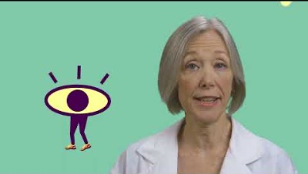
Audio Described version…
Online version of this video: https://youtu.be/ct1xKw_s6Is
Notes:
Video transcription:
AD voiceover: Ask a scientist, with Dr. Cheri Wiggs
Child: What happens to my eyes when I cry?
Scientist: Anytime you cry, you think of tears, whether you're shedding a tear, or crying a bucket of them. All of these tears are produced by something called the lacrimal gland, that's located between the surface of the eye, and the eyelid, just above here.
AD voiceover: point to eyebrow
Scientist: There are three different kinds of tears. The first are basal tears, those are constantly produced, they keep your eye lubricated and nourished. The second kind, reflex tears, are actually produced in response to an irritant, like smoke in the air or a runaway eyelash on the surface of your eye. But what about when your best friend moves away, or you see a sad movie? Those tears, emotional tears, are produced, but scientists still don't know what their purpose is.

Slide 17
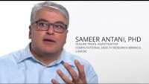
Example: Extended Audio Description
https://youtu.be/Exr6Rr9YNFw

Slide 18
Issues and Considerations
Variations in style and completeness
Classic manually recorded AD
Automated voice AD
Choosing the correct complexity of AD
Challenges of AD for complex content
What would a member of your target audience need to know or understand from visuals?
Who will write/ edit the AD script?
Expertise
Subject matter expertise
Technical expertise (video, audio editing)

Slide 19

Bricks without straw

Slide 20
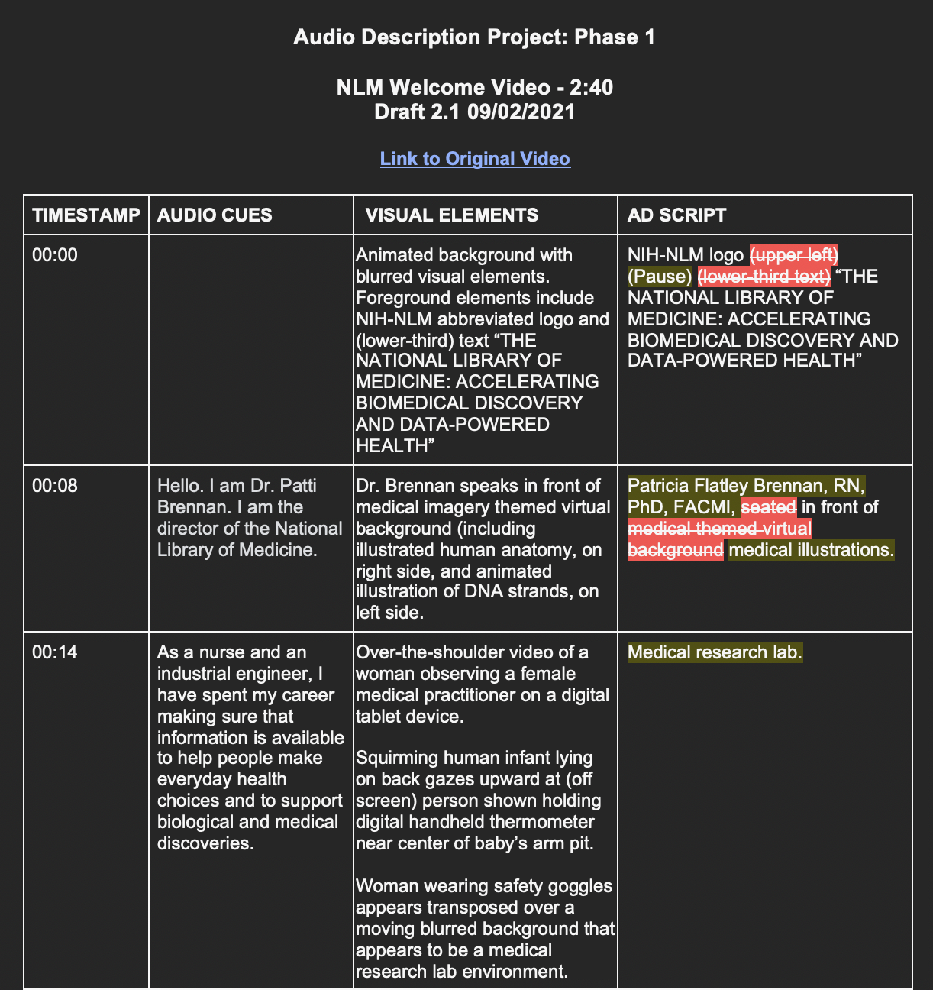
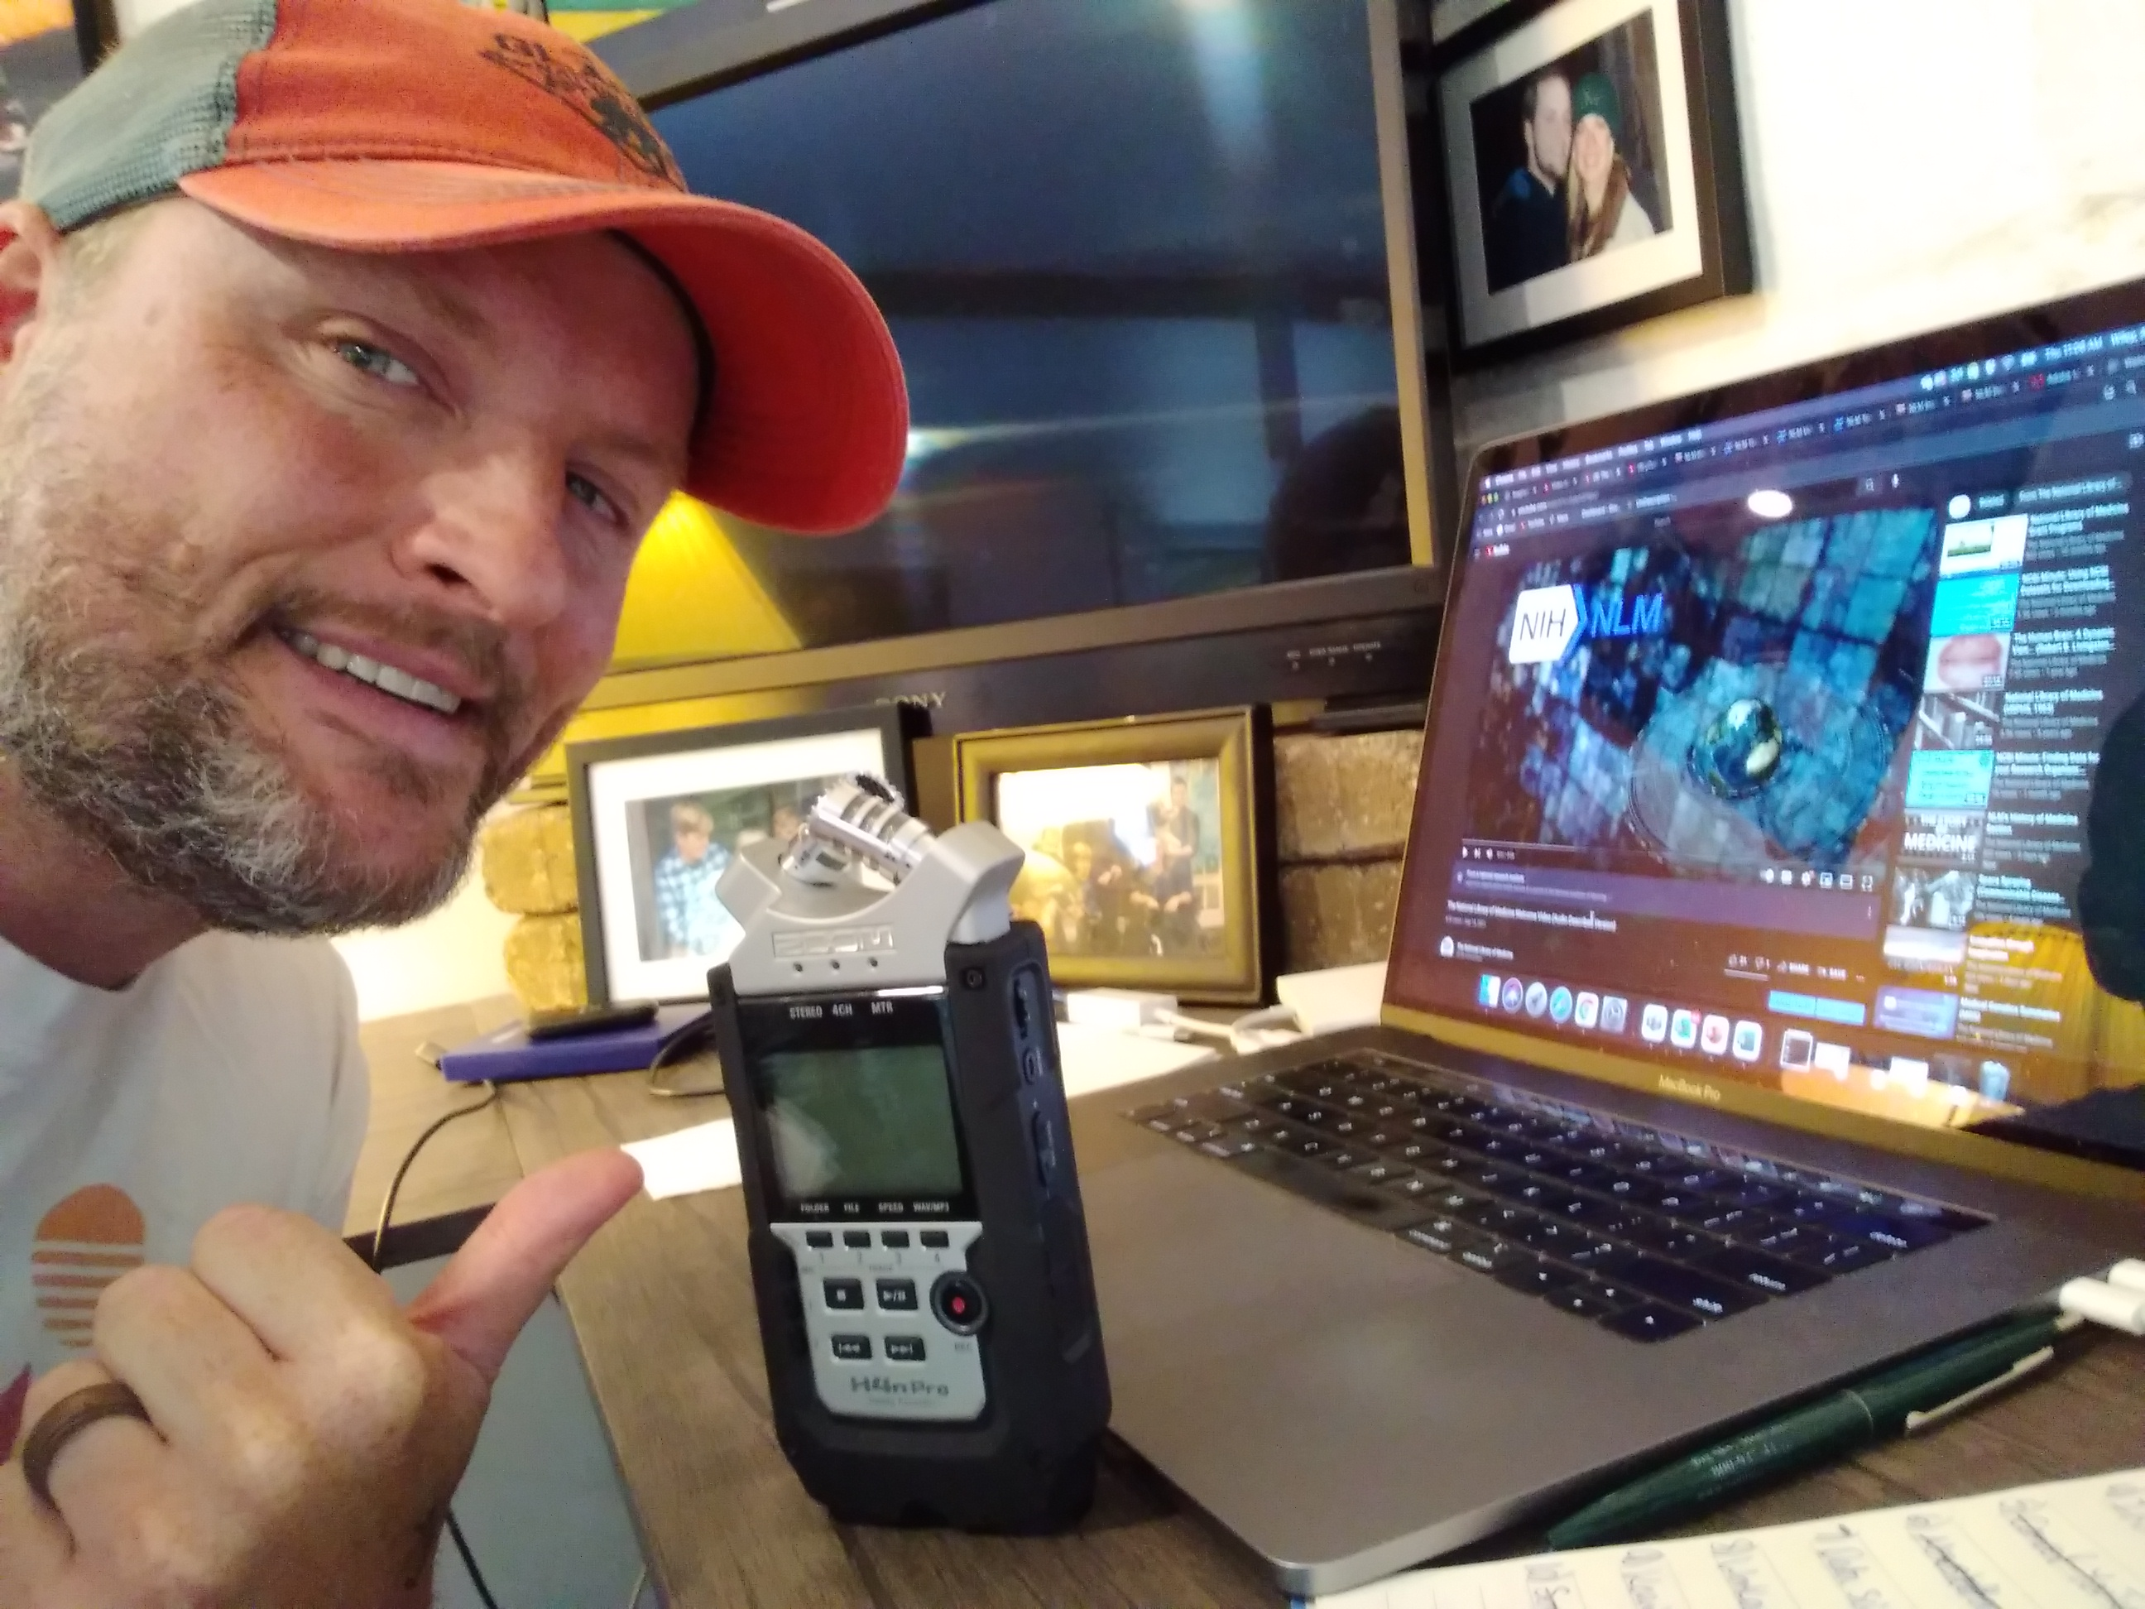
Recording Audio Description

Slide 21
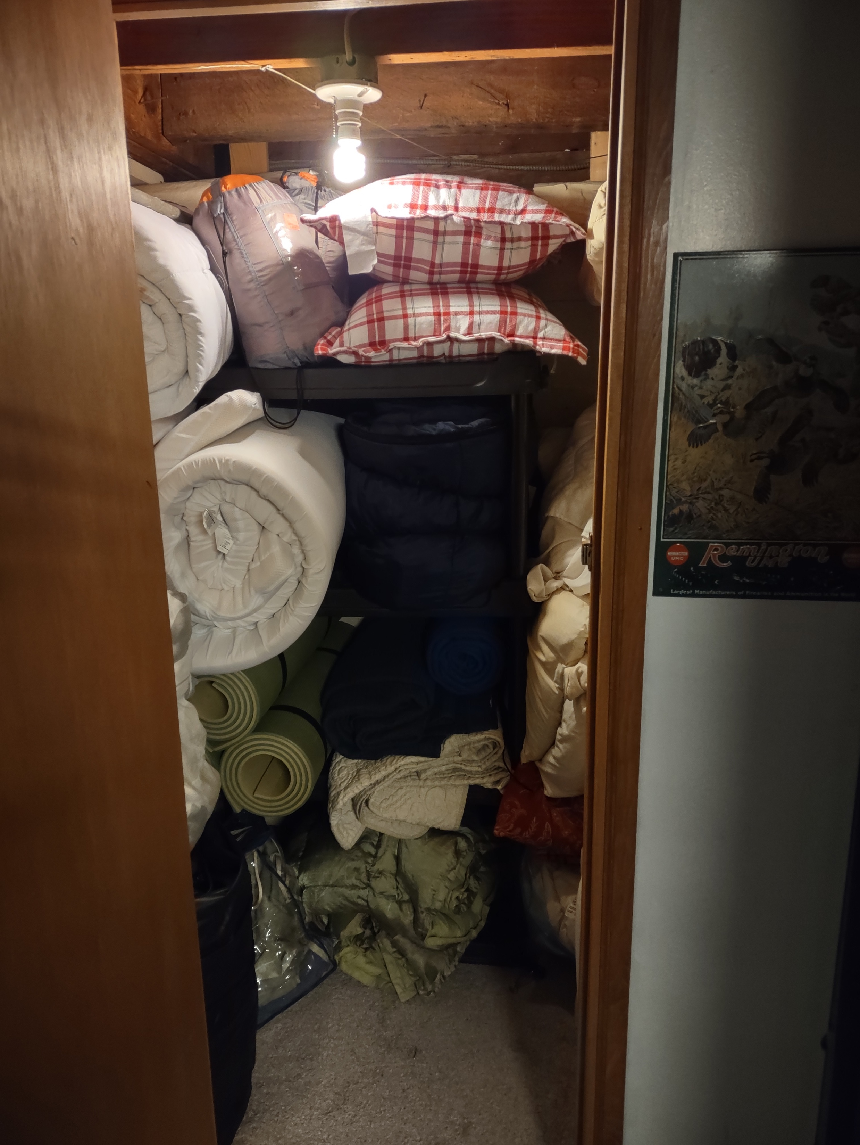
My Recording Studio

Slide 22
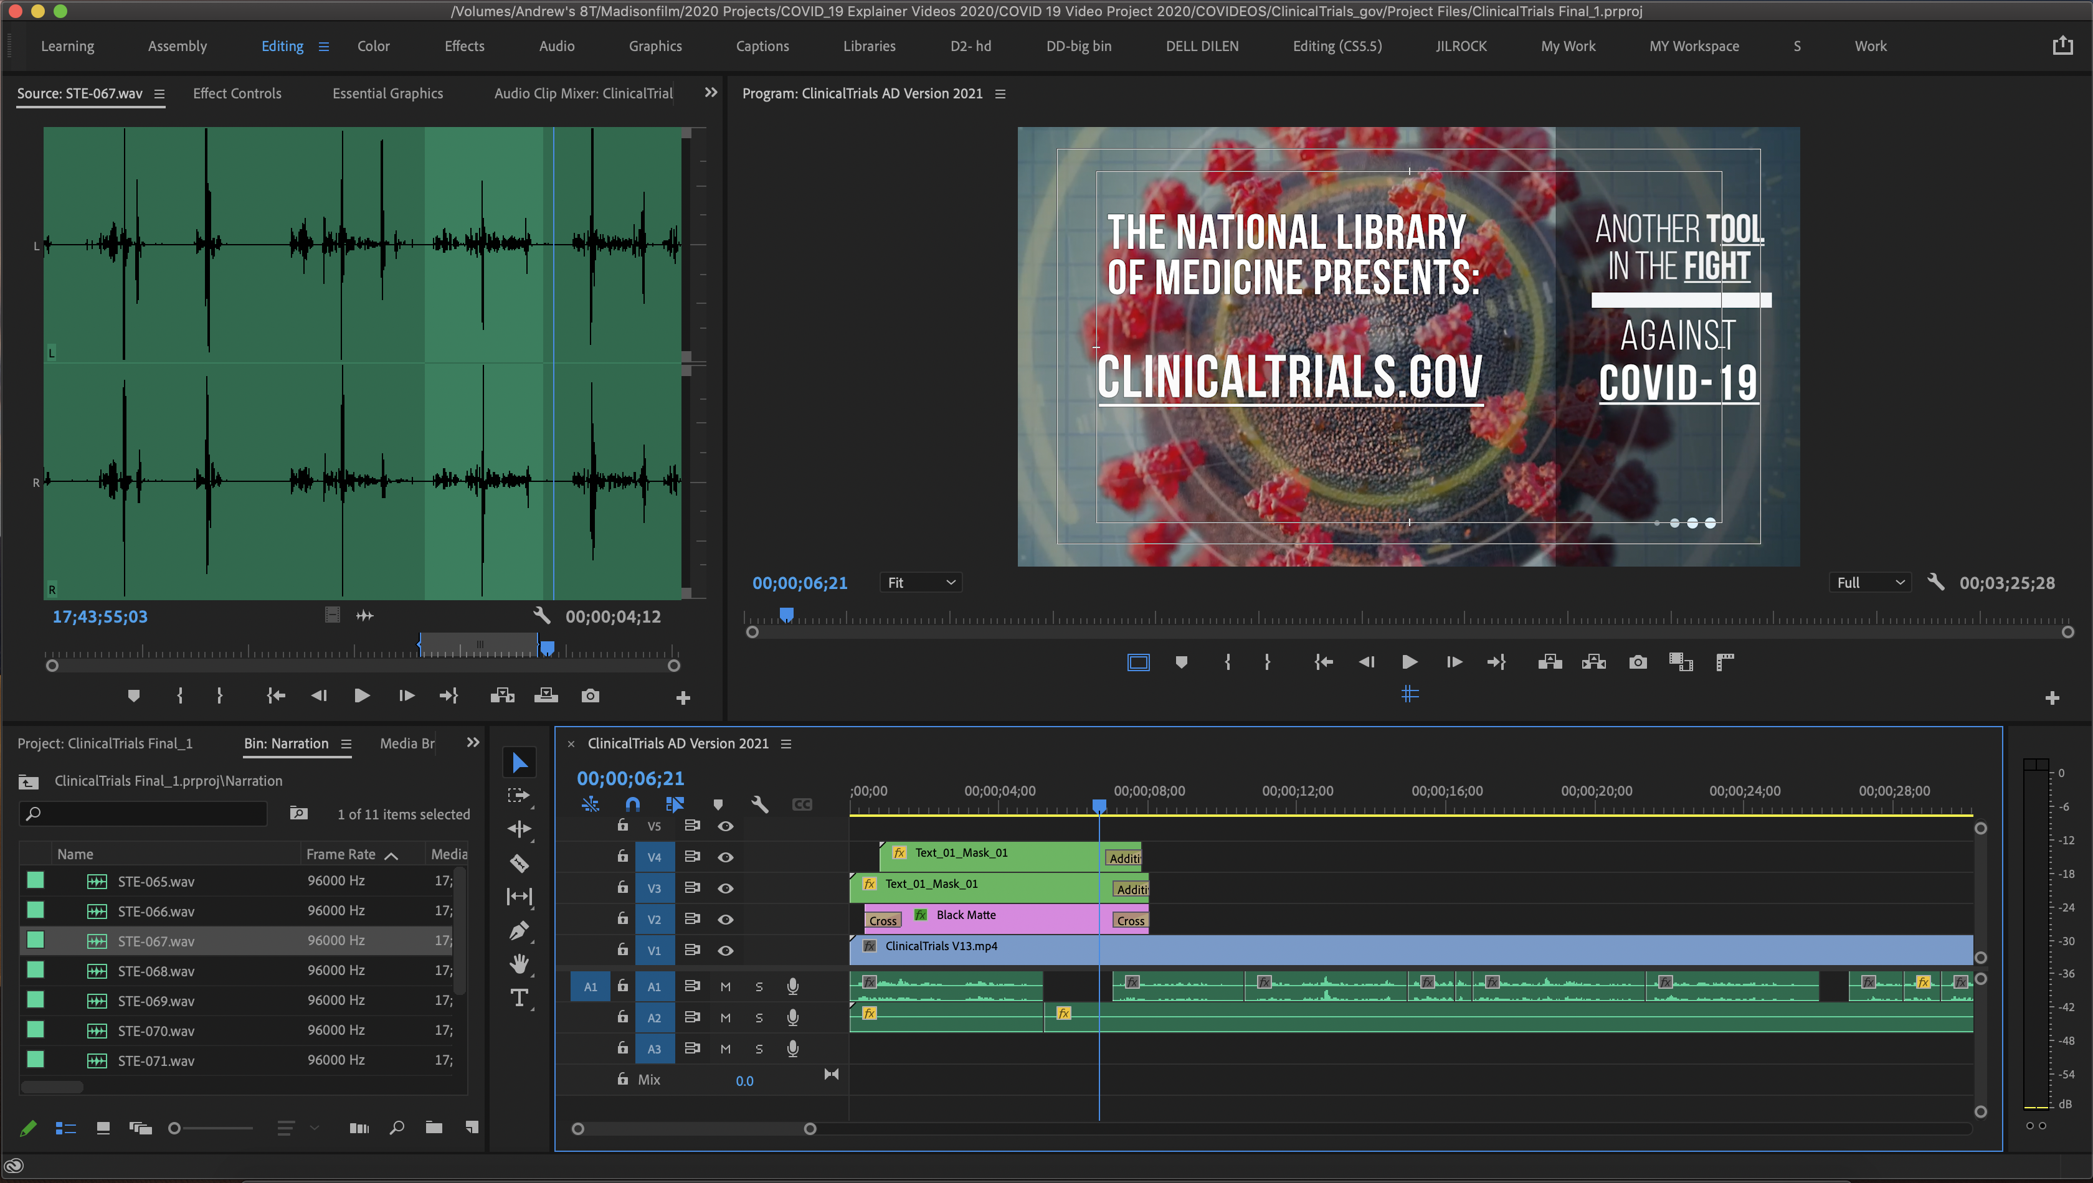
Making a video in Premiere Pro

Slide 23
Posting and Promoting Audio Described Videos

Slide 24
Parallel Audio Tracks vs. Parallel Videos

Slide 25
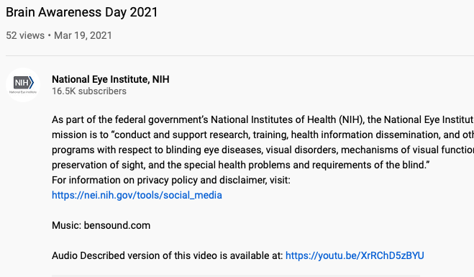
Using YouTube with Audio Description
YouTube is not compatible with audio description
Our recommendation:
Create parallel videos
Upload videos separately to YouTube with “Audio Described” in the title of the AD version
Cross-link the two videos in the video description
If you embed the non-audio described version on your website, add a clearly labeled link in the video’s caption to the AD version

Slide 26
AD-Compatible Video Players for Web
Some video players will allow users to toggle between either dual audio track videos, or between parallel video files, a requirement for fully compliant websites. YouTube’s player is not fully 508 compliant.
Video Player | Parallel Audio Tracks | Parallel Video Tracks | Compatible with YouTube | Cost or Free? | Browser-based | Website
Able Player | Maybe? | Yes | Yes | Free | Yes | https://ableplayer.github.io/ableplayer/
JW Player | Yes | No | Yes | Cost | Yes | https://www.jwplayer.com
OzPlayer | Yes | No | Yes | Cost | Yes | https://www.accessibilityoz.com/ozplayer/
Video.js | Yes | No | No? | Free | Yes | https://videojs.com
Wistia Player* | Yes | No | No | Cost | Yes | https://wistia.com/product/player
3Play Media* | Yes | No | No | Cost | Yes | https://www.3playmedia.com/
YouTube with custom Drupal solutions^ | No | No | Yes | Free | Yes | N/A

Slide 27
NLM Promotion of AD Videos
AD videos only useful if those who need them know about them!
Develop a communications plan

Slide 28
Develop a Communications Plan
Project Name: Promoting NLM Audio Described Videos
Overview: To be compliant with Section 508 accessibility standards, Digital.gov states that “the person watching [a video] must be able to understand what is happening in both the visual and audio portions of the video.” In this spirit, NLM has created a series of audio described videos covering a range of topics that illustrate activities in which NLM is involved. These videos are meant to give blind and visually impaired viewers a better sense of NLM research, resources, and more.
Goals: To ensure that interested viewers in need of audio descriptions are aware of NLM’s videos
Key Messages:
NLM is committed to ensuring that blind and visually impaired individuals can access and enjoy NLM videos.
Nobody should feel excluded from any NLM resources based on disability.
NLM takes Section 508 accessibility standards seriously and incorporates these principles into everything we do.

Slide 29
Identify Your Stakeholders
NIH Stakeholders
NIH Office of Equity, Diversity, and Inclusion
NIH 3 Blind Mice Listserv
Network of the National Library of Medicine
NIH and Institute/Center Section 508 coordinators
NIH Social Media Collaboration Group
NLM IDEA Group

Slide 30
Identify Your Stakeholders cont.
Government
Digital.gov’s IT Accessibility Community of Practice
Library of Congress’ National Library Service for the Blind and Print Disabled
Department of Labor’s Office of Disability Employment Policy
Consumer Organizations:
American Council of the Blind
National Federation of the Blind
Lighthouse for the Visually Impaired and Blind
American Diabetes Association
American Foundation for the Blind
American Macular Degeneration Foundation
American Printing House for the Blind
Association for Macular Diseases/Ophthalmic Edge
Glaucoma Research Foundation
Hadley School for the Blind
Macular Degeneration Foundation
Macular Degeneration Partnership
Macular Degeneration Association
MD Support, list of support groups
National Federation of the Blind
National Industries for the Blind
Vision Aware
NEI’s Eye Health Organizations Database:
https://www.nei.nih.gov/learn-about-eye-health/eye-conditions-and-diseases/eye-health-organizations-database

Slide 31
Identify Priority Steps
Key Message Strategy | Tactic | Dissemination Channel | Audience | Lead | Proposed Date | Date Completed
Promotion through NIH EDI platforms | Email to EDI contact | EDI website and social media channels | NIH employees | TBD | TBD | TBD
Blast Email to Relevant NIH/NLM Parties | Listserv email | NIH 3 Blind Mice listserv; NNLM listserv(s) | NIH employees; health professionals involved with NNLM | TBD | TBD | TBD
Promotion to Members of the NIH Social Media Collaboration Group | Presentation | PowerPoint presentation followed by a reminder over the listserv | NIH social media collaborators | TBD | TBD | TBD
Promotion to Federal Community of Practice | Email to IT Accessibility Community of Practice | 508 listserv | U.S. Government professionals who work to enhance access to federal information technology | TBD | TBD | TBD

Slide 32
Identify Priority Steps cont.
Key Message Strategy | Tactic | Dissemination Channel | Audience | Lead | Proposed Date | Date Completed
Collaborate with the National Library Service for the Blind and Print Disabled | Email to point of contact to see how they can help with promotion | Email and social media channels | People with temporary or permanent low vision, blindness, or a physical, perceptual, or reading disability | TBD | TBD | TBD
Promotion on Social Media by Select Consumer Organizations | Emails to point of contact at consumer organizations | Email and social media channels | Members of consumer organizations | TBD | TBD | TBD

Slide 33
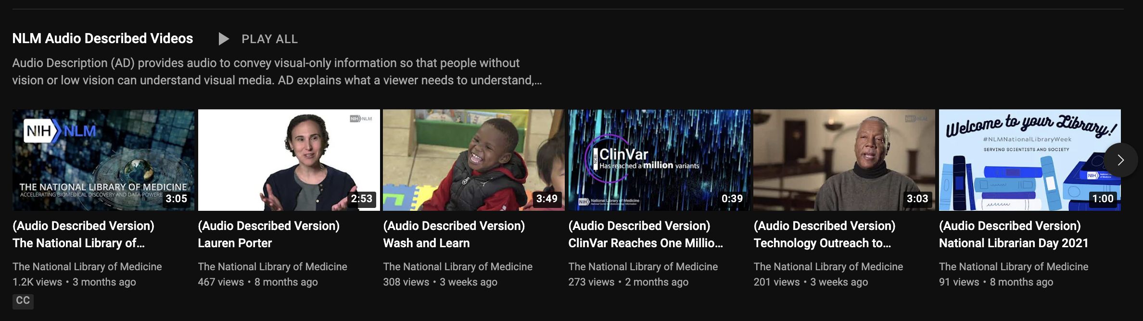
YouTube AD playlists

Slide 34
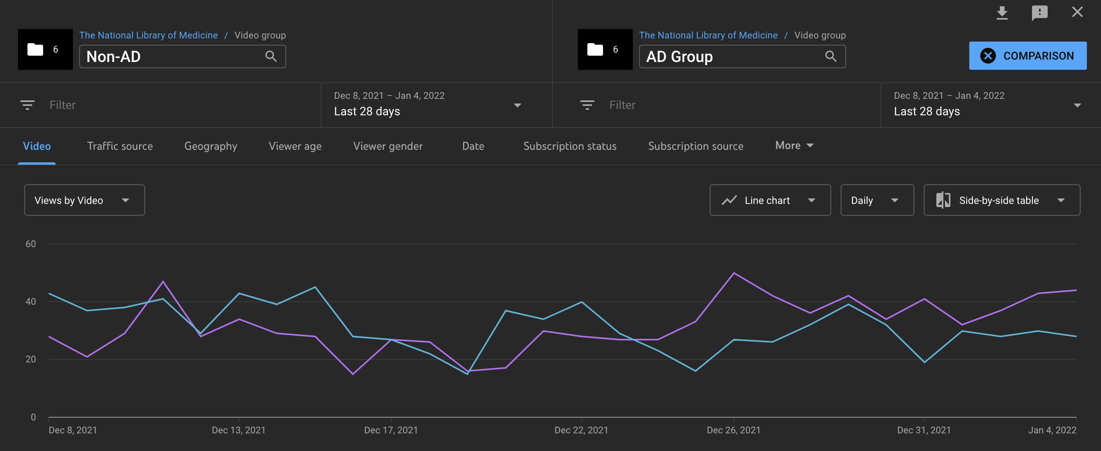
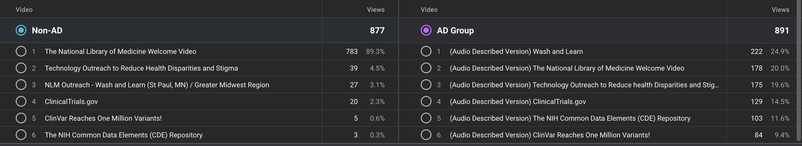
NLM video analytics, continued
Non-AD: Blue
AD: Purple

Slide 35
NEI and NLM Audio Described Playlists
NLM Audio Described videos (17)
NEI Audio Described videos (61)

Slide 36


Contact Information
Lesley Earl
Andrew Wiley
Alison Lemon
Section 508 Coordinator/ Science Writer
National Eye Institute
Lesley.earl@nih.gov
Video Producer
National Library of Medicine
Andrew.wiley@nih.gov
Web/Digital Team Lead
National Library of Medicine
Alison.lemon@nih.gov

